Slide 1
Asset pricing factors
Share issuance fator – Pontiff and Woodgate (JF, 2008)
Volatility spread fator – Bali and Hovakimian (MS, 2009)

Slide 2
Share issuance - Pontiff and Woodgate (JF, 2008)
Pontiff and Woodgate (2008) use net issuance of stocks in Fama-MacBeth (1973) method to explain stocks cross-sectional returns.
They measure net issuance in past one year based on literature and ease of use, and past five years, based on Daniel and Titman (2006) tangible and intangible story. They find that both are significant for cross-section. They do not theoretically position their findings, though.
The idea is that insiders/managers seeing that the firm is overvalued, given intangible information (that is, non-financials), issue shares. This is just slowly assessed by other investors. Hence, issuance is negatively related to future returns.

Slide 3
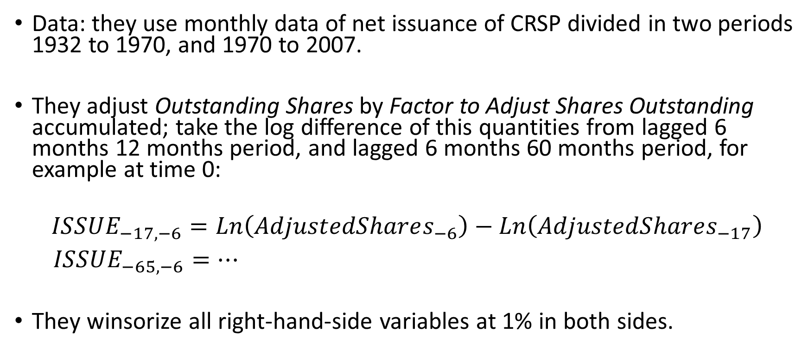
Share issuance characteristic measure
Data: they use monthly data of net issuance of CRSP divided in two periods 1932 to 1970, and 1970 to 2007.
They adjust Outstanding Shares by Factor to Adjust Shares Outstanding accumulated; take the log difference of this quantities from lagged 6 months 12 months period, and lagged 6 months 60 months period, for example at time 0:
$$ISSUE_{−17,−6}=Ln\left(AdjustedShares_{−6}\right)−Ln\left(AdjustedShares_{−17}\right)$$
$ISSUE_{−65,−6}=…$
They winsorize all right-hand-side variables at 1% in both sides.

Slide 4
Volatility spreads - Bali and Hovakimian (MS, 2009)
It is widely documentend that stock returns exhibit both stochastic volatility (decomposed as a continuous Brownian motion) and jumps.
Pan (2002) presents evidence of a jump-risk premium at the market level, Bali and Hovakimian (2009) will test this jump risk for individual stocks, proxying it by call-put implied volatility.

Slide 5
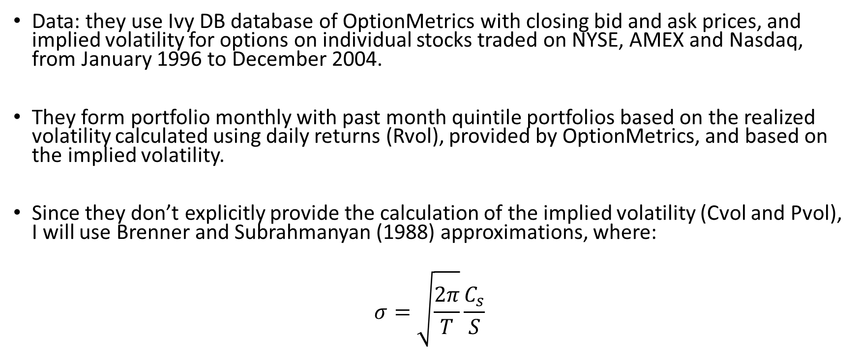
Volatility spread measure
Data: they use Ivy DB database of OptionMetrics with closing bid and ask prices, and implied volatility for options on individual stocks traded on NYSE, AMEX and Nasdaq, from January 1996 to December 2004.
They form portfolio monthly with past month quintile portfolios based on the realized volatility calculated using daily returns (Rvol), provided by OptionMetrics, and based on the implied volatility.
Since they don’t explicitly provide the calculation of the implied volatility (Cvol and Pvol), I will use Brenner and Subrahmanyan (1988) approximations, where:
$$σ=\sqrt{\frac{2π}{T}}\frac{C_{s}}{S}$$

Slide 6
Volatility spread measure
They form the value-weighted (and equal-weighted) portfolios by quintiles buying the most volatile underlying stocks and selling the less volatile ones, measured by Rvol and (Cvol – Pvol), only.
They find positive portfolio diferences-in-differences returns.

Slide 7
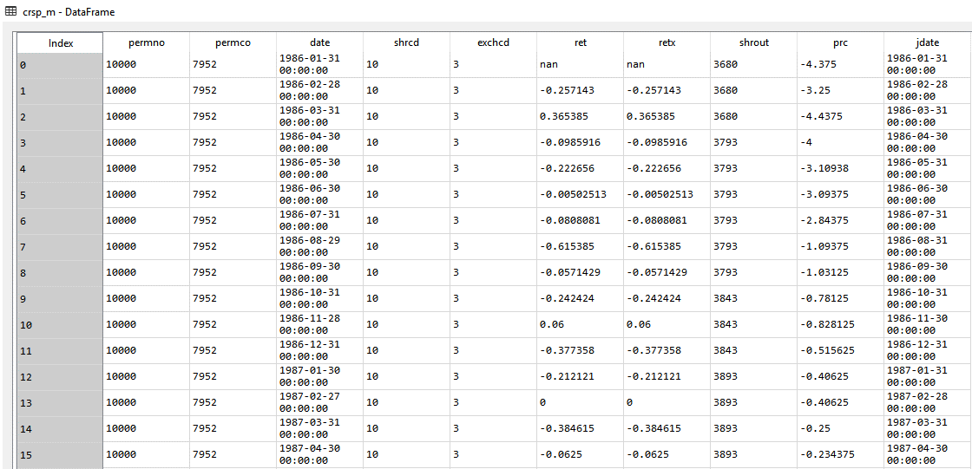
CRSP dataset
PERMNO is a unique permanent security identification number assigned by CRSP to each security.
EXCHCD is a code indicating the exchange on which a security is listed.
SHRCD is a two-digit code describing the type of shares traded. The first digit describes the type of security traded.
RETX is the return adjusted for dividends.
SHROUT is the shares outstanding.
PRC is the closing price. If it is not available for any given period, the number in the price field is replaced with a bid/ask average. Bid/ask averages have dashes placed in front of them. These do not wrongly reflect negative prices, but serve simply to distinguish bid/ask averages from actual closing prices.
For more details and other columns, please access: http://www.crsp.com/products/documentation/crsp-us-stock-and-index-databases-data-descriptions-guide

Slide 8
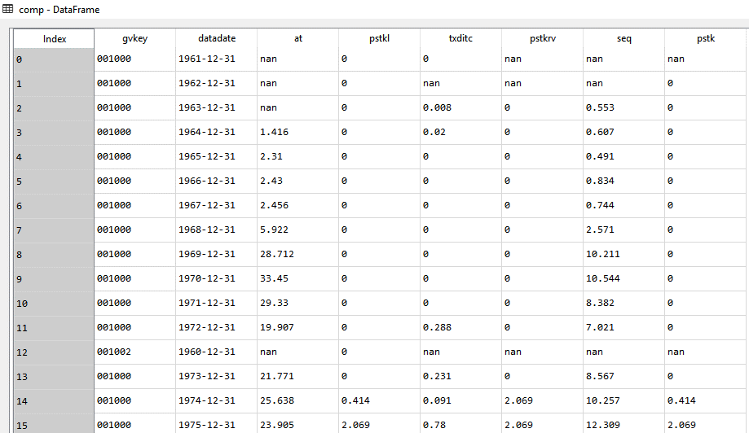
Compustat dataset
GVKEY is a unique six-digit number key assigned to each company (issue, currency, index) in the Capital IQ Compustat database. It is a company (issue, currency, index) identifier similar to a TICKER symbol.
PSTK = Preferred/Preference Stock
PSTKL = Preferred Stock/Liquidating Value
TXDITC = Deferred Taxes and Investment Tax Credit
SEQ = Stockholders' Equity – Total
AT = Total assets
For more details and other columns, please access: http://www.crsp.com/products/documentation/annual-data-industrial

Slide 9
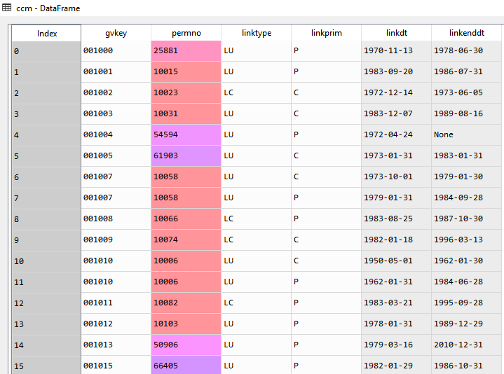
CCM dataset
LINKDT is a calendar date marking the first effective date of the current link.
LINKENDDT is the last effective date of the link record.

Slide 10
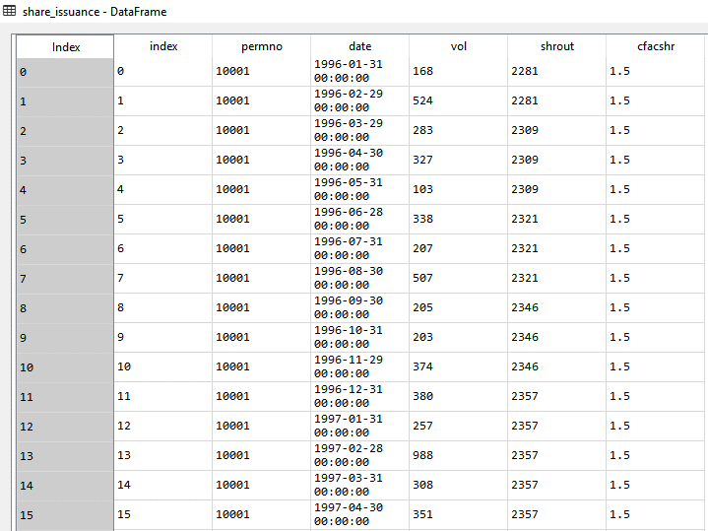
Share issuance – All columns available in CRSP
LINKDT is a calendar date marking the first effective date of the current link.
LINKENDDT is the last effective date of the link record.
For more details and other columns, please access: http://www.crsp.com/products/documentation/crsp-us-stock-and-index-databases-data-descriptions-guide

